Slide 1
DNA Corpus
Abdul samad 19k-0158
Sufiyan-UR-RehMAn 19i-0583
Salman SAJID 19k-0196

Slide 2
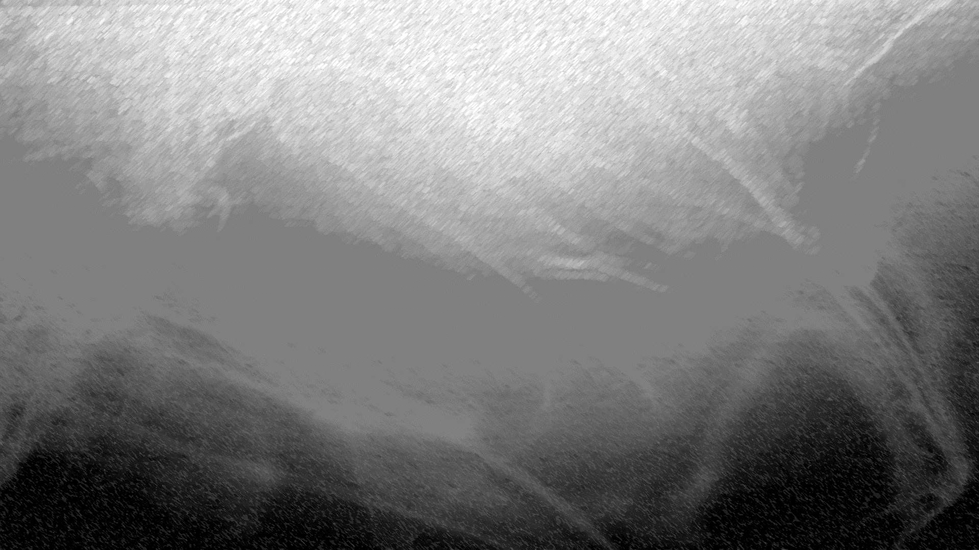
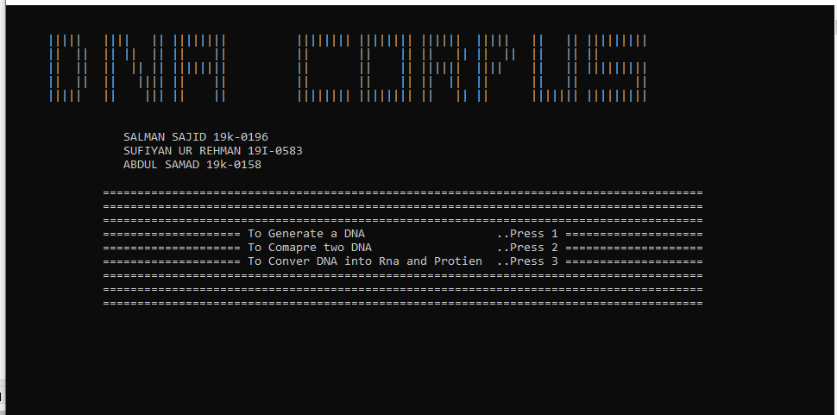

Slide 3

introduction :
Project based on bio-informatics
Project is divided into three parts
DNA GENERATION
DNA comparison
DNA → RNA → Protein

Slide 4
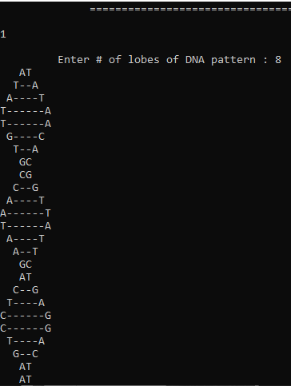
Process:
DNA GENERATION :
By pressing 1 we jump to DNA generation where we can generate the data we need. This step is necessary b/c some times we don’t have the data we need so either we can select the data from thousands of articles or simply generate our kind of data

Slide 5
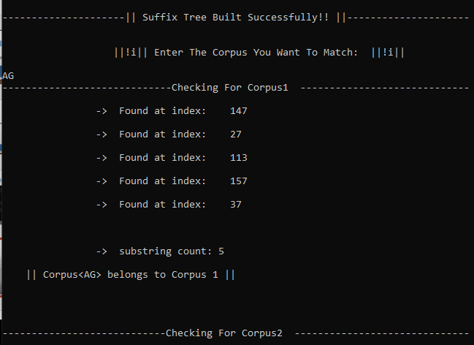
COMPARE TWO DNAs:
Here we can compare 2 DNA corpus as you can basically understand from the name . Here we can also search a single and multi combination of lobes in a DNA corpus with the exact location.

Slide 6
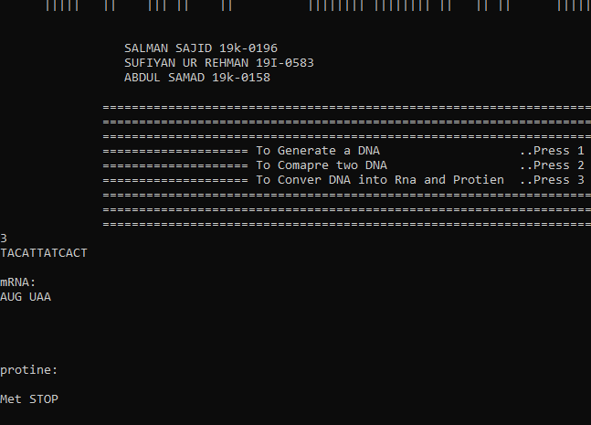
DNA TO RNA AND PROTEIn :
Here we can convert our DNA into RNA and Protein with some combinations describe in our code, also the DNA to RNA conversion with specific key words like (A,G,C,T ) in DNA and (U,C,G,A) in RNA and for Protein we use:
{Phe","Phe","Leu","Leu","Ser","Ser","Ser","Ser","Tyr","Tyr","STOP","STOP","Cys","Cys","STOP","Trp","Leu","Leu","Leu","Leu","Pro","Pro","Pro","Pro","His","His","Gin","Gin","Arg","Arg","Arg","Arg","Ile","Ile","Ile","Met","Thr","Thr","Thr","Thr","Asn","Asn","Lys","Lys","Ser","Ser","Arg","Arg","Val","Val","Val","Val","Ala","Ala","Ala","Ala","Asp","Asp","Glu","Glu","Gly","Gly","Gly","Gly“}

Slide 7
Thank you 👉👈

